Slide 1
Similarity-based SPARQL Operators
Sebastián Ferrada
scferradaa@gmail.com
sferrada.com

Slide 2
0.- Who am I?

Slide 3
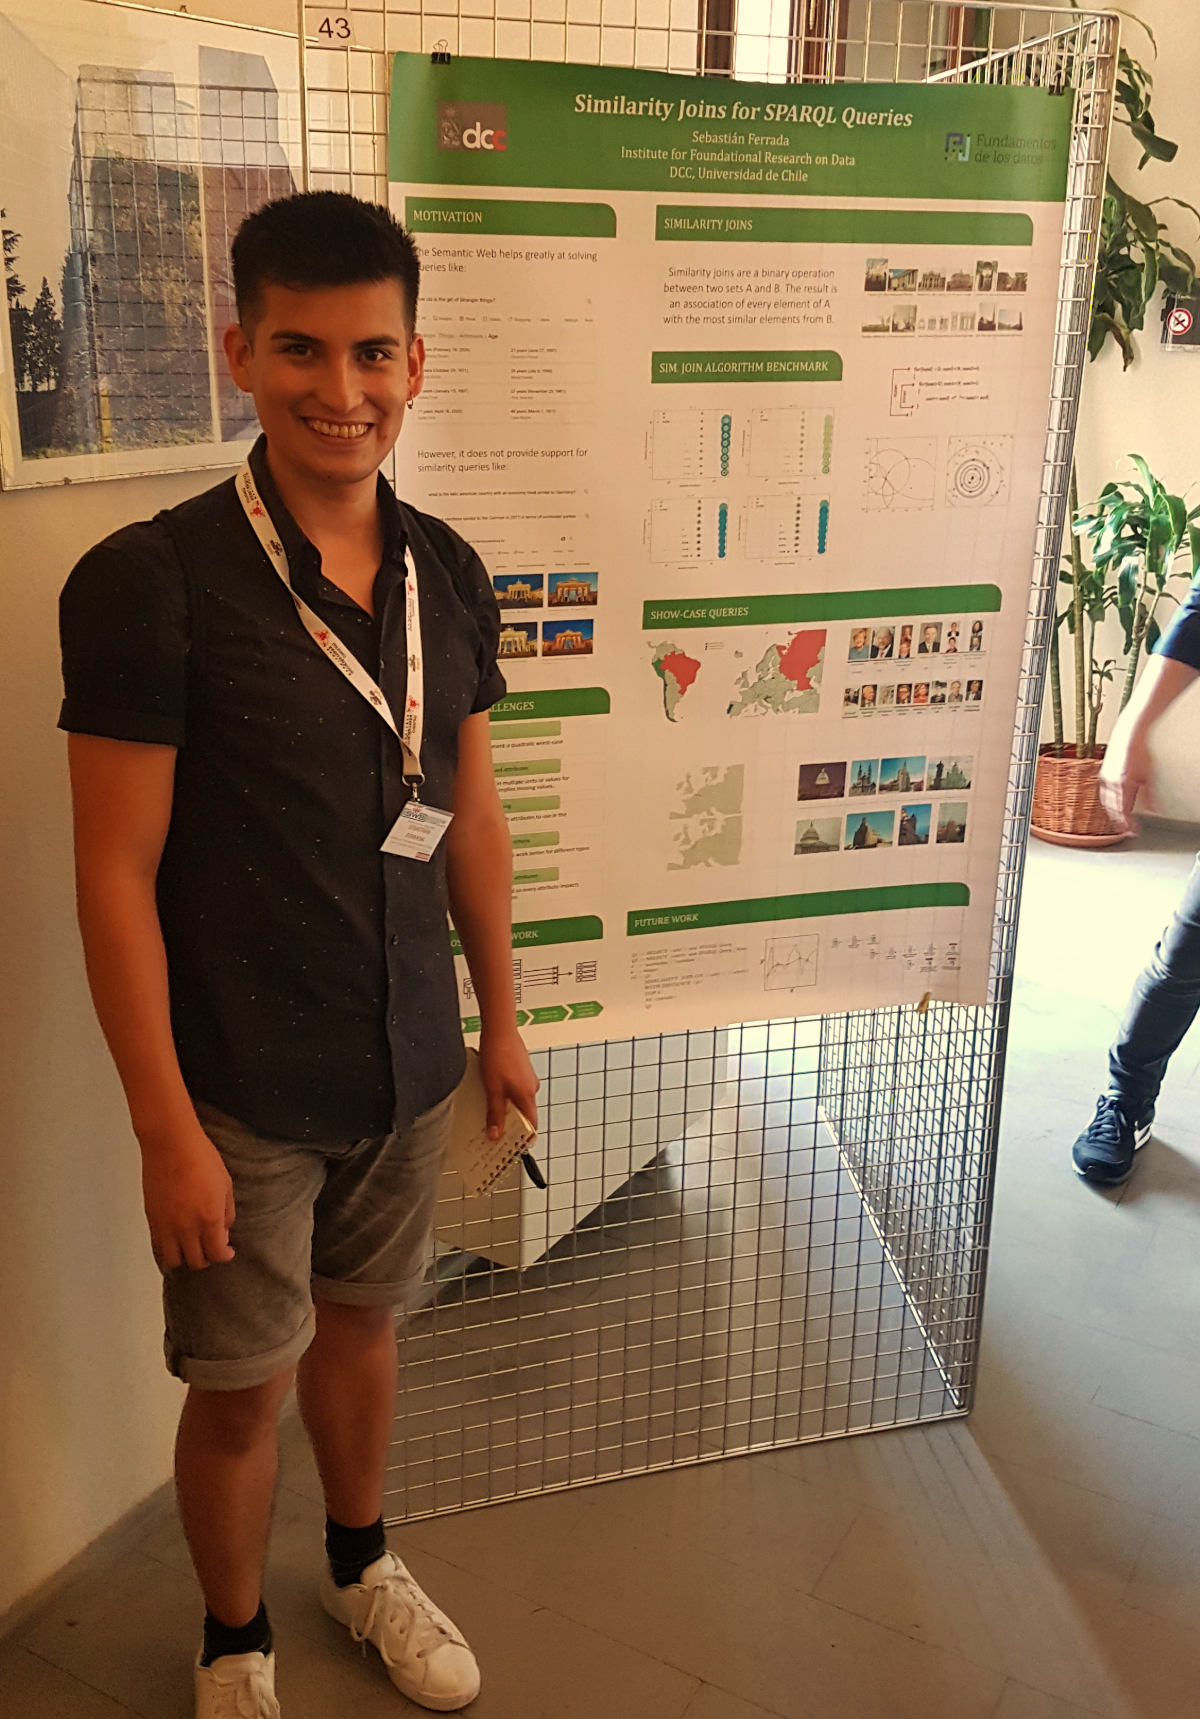
Sebastián
Chilean, soon to get my PhD
Made my thesis about similarity in the Semantic Web
Will be working with Olaf as postdoc
Hope to travel soon to Sweden
Love coffee and beer

Slide 4

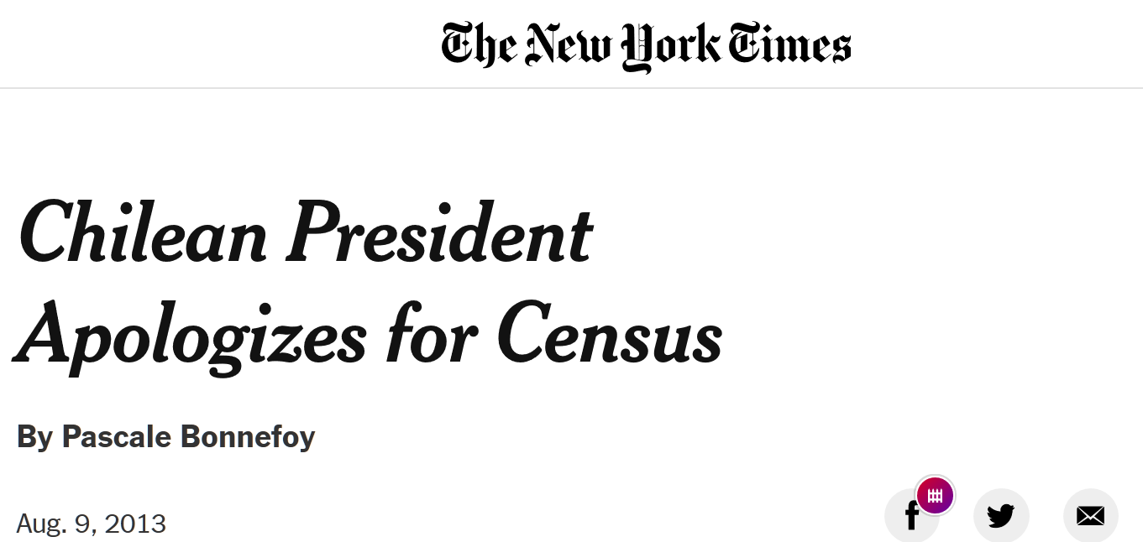
Chile
17 million people (as far as we know)

Slide 5
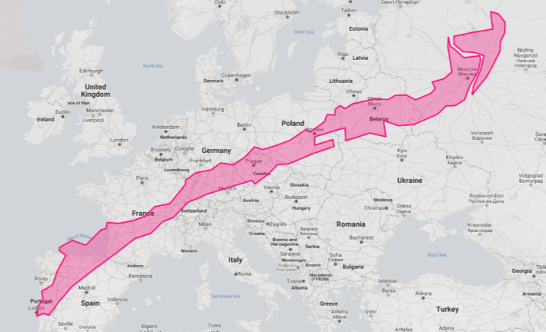
Chile
Super long: same distance from Lisbon to Moscow

Slide 6
Chile
Allegedly, an economic oasis in Latin America

Slide 7
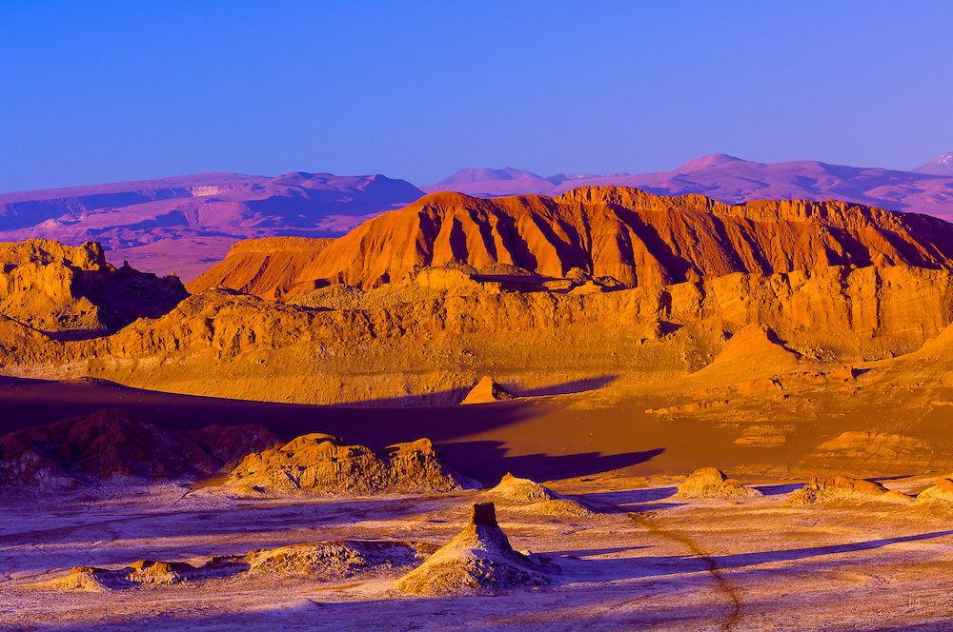
Chile
Very nice weather, although the driest dessert on Earth is expanding

Slide 8
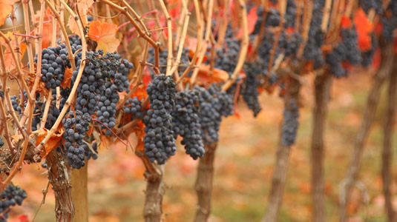
Chile
Best wine in the world, much better than French

Slide 9
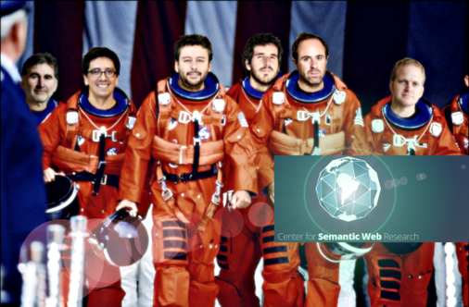


I. for Foundational Research on Data
“We explore the foundational problems on data in order to understand its complexity, extract its value and turn it into a benefit for society”.

Slide 10
1.- Motivation
Notes:
Hello everyone. I hope you and your loved ones are safe. Welcome to my talk.

Slide 11
Exact Queries
Exact queries match the query patterns with the data
If nothing matches exactly, the query does not retrieve results

Slide 12

Exact Queries (on the Web)
nobel prize winners in literature

Slide 13
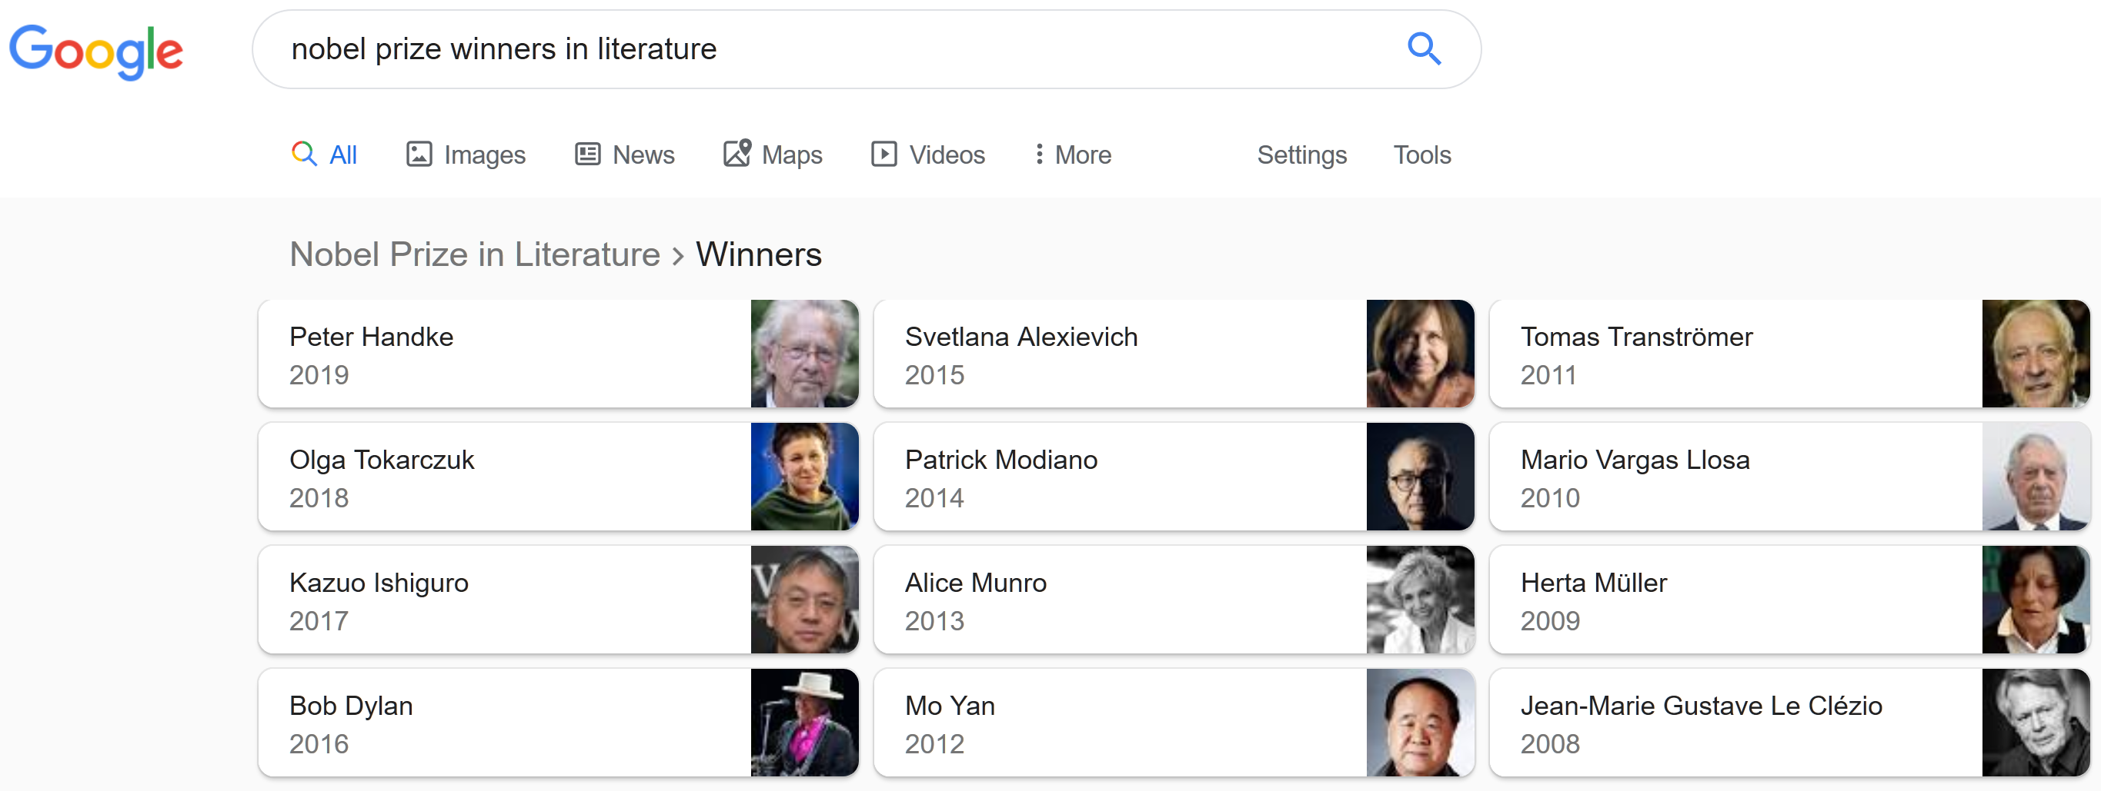
Exact Queries (on the Web)
Notes:
what is the semantic web: part of the cs that aims that web data is machine understandable thus allowing people to express more powerful queries

Slide 14

Exact Queries (on the Web)
nobel prize winners in literature that fought in a war

Slide 15
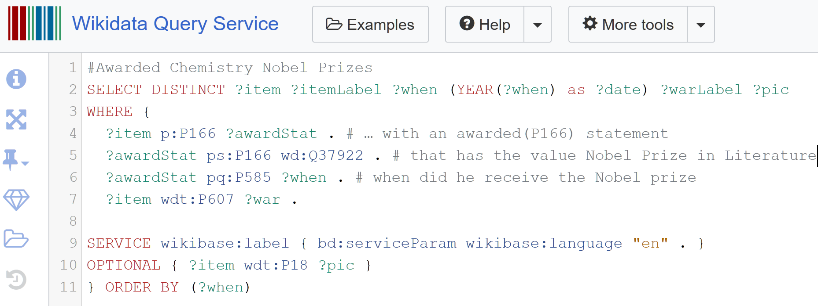
Exact Queries (on the Semantic Web)

Slide 16
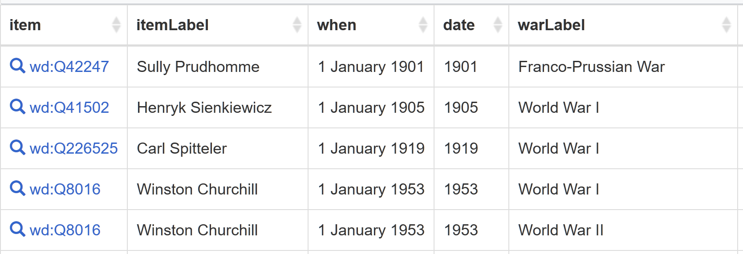
Exact Queries (on the Semantic Web)

Slide 17
Similarity Queries
Similarity queries retrieve objects that are similar to the query, not necessarily matching exactly

Slide 18
Similarity Queries (on the Web)
books similar to harry potter

Slide 19
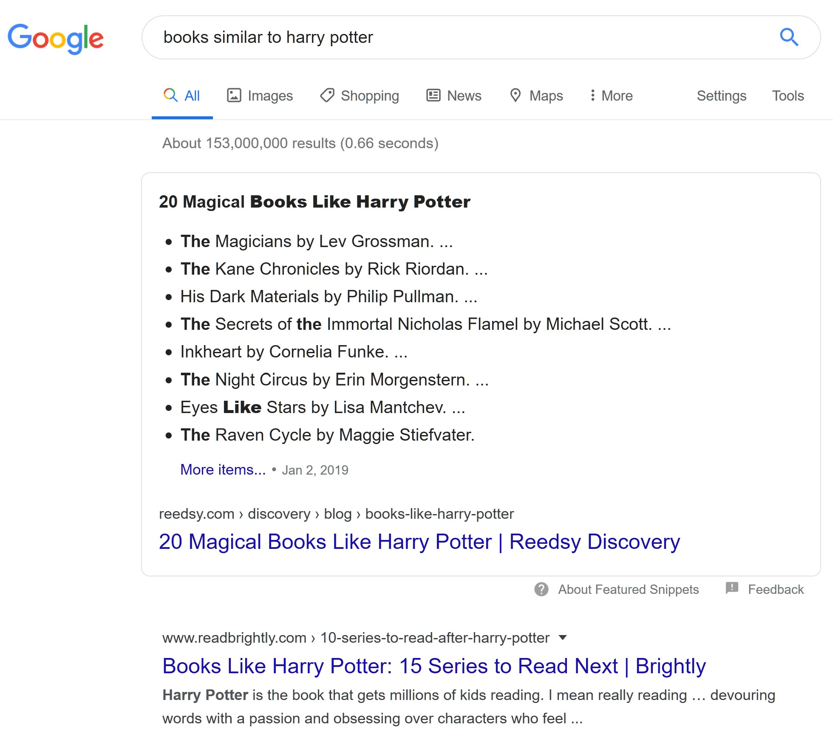
Similarity Queries (on the Web)

Slide 20
Similarity Queries (on the Web)
Latin American countries with similar population and GDP to Ireland

Slide 21
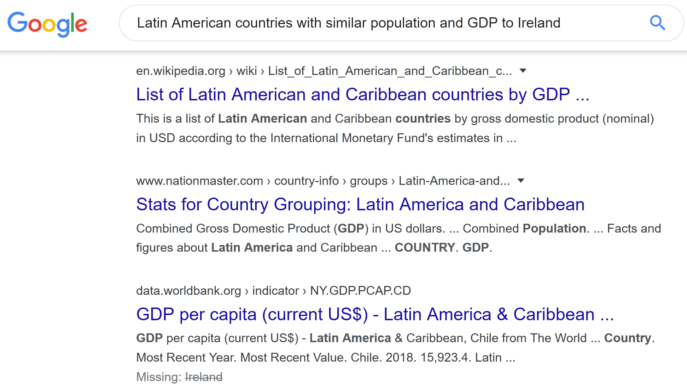
Similarity Queries (on the Web)

Slide 22
2.- The Goal

Slide 23
To provide users with means for executing similarity queries in the context of the Semantic Web

Slide 24
3.- Definitions

Slide 25
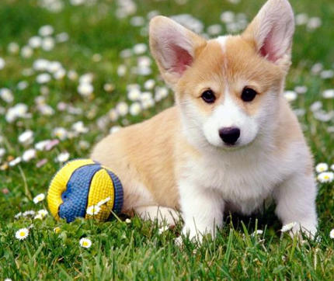

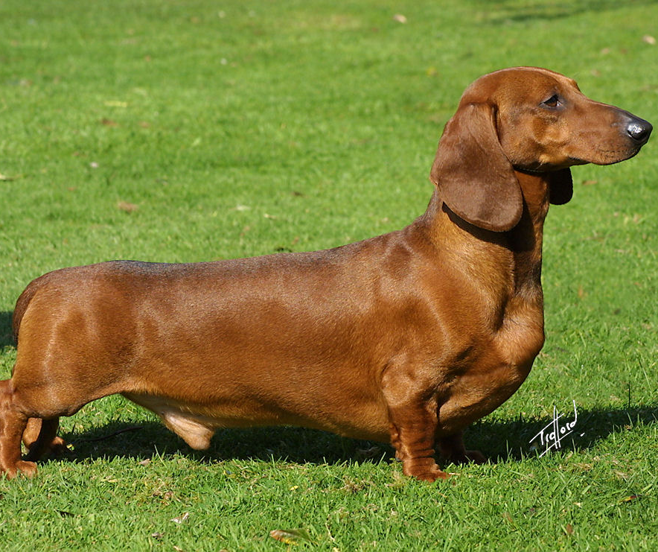
Similarity
Similarity among objects depends on many factors:
The application goals
Human appreciation
The nature of the object
Semantic contexts
Many more...

Slide 26
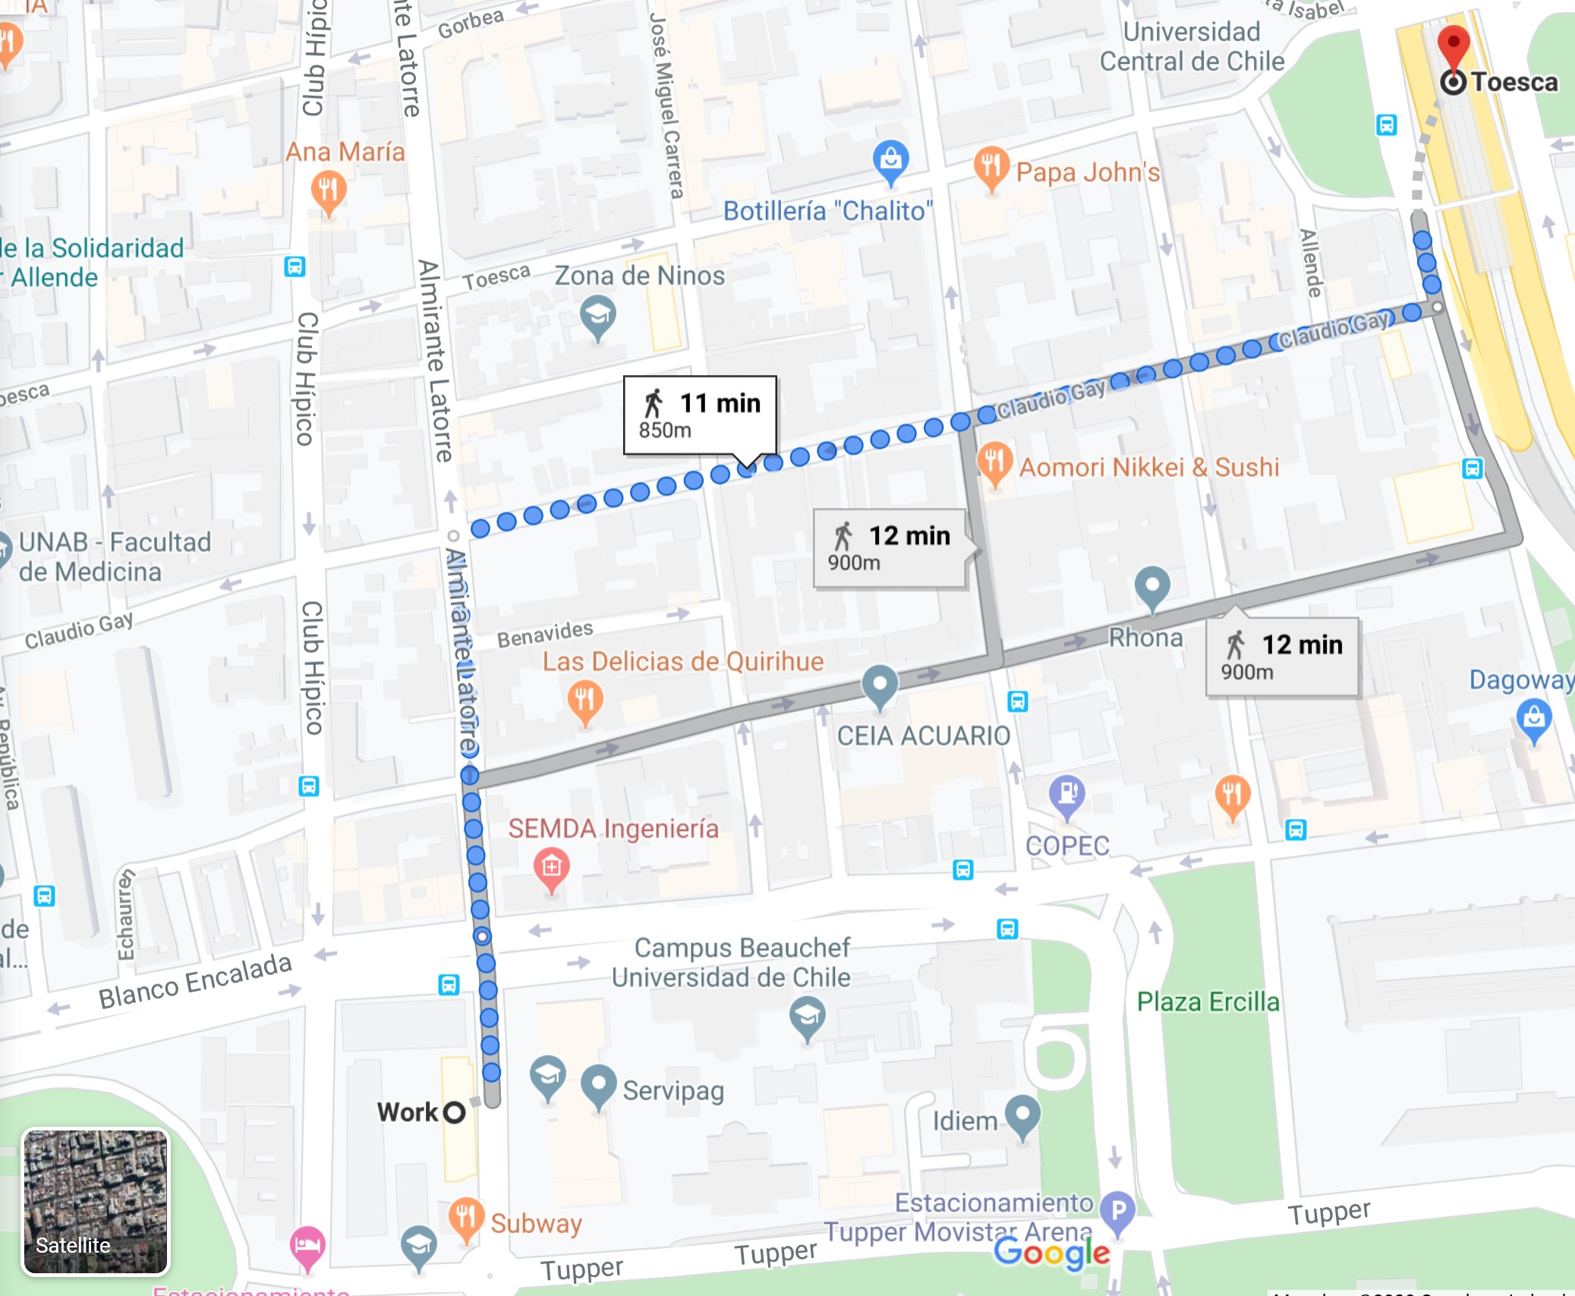
Similarity – Distance Functions
We focus on distances as a similarity measure.
Mainly metric distances
750m

Slide 27
Two objects are as similar as they are close in their metric space

Slide 28
Similarity Joins
Given two datasets, their similarity join contains all pairs of similar objects, one of each dataset

Slide 29
Similarity Join – Range-based
r
Find all pairs ( , ) that are at distance of at most r

Slide 30
Similarity Join – Nearest Neighbours
k=3
Find all pairs ( , ) such that is one of the k nearest neighbours of

Slide 31
Similarity Join
Note that a brute force algorithm computing the join will verify that each pair of objects satisfies the similarity criteria, which is a nested loop

Slide 32
Similarity Join – Example
Find pairs of Latin American and European countries with the most similar GDP and Human Development Index
Panama
Portugal
Chile
Germany
Peru
Mexico
Sweden
Argentina
Montenegro
Ireland
El Salvador
HDI
Brazil
Greece
Ecuador
France
Bolivia
Russia
GDP

Slide 33
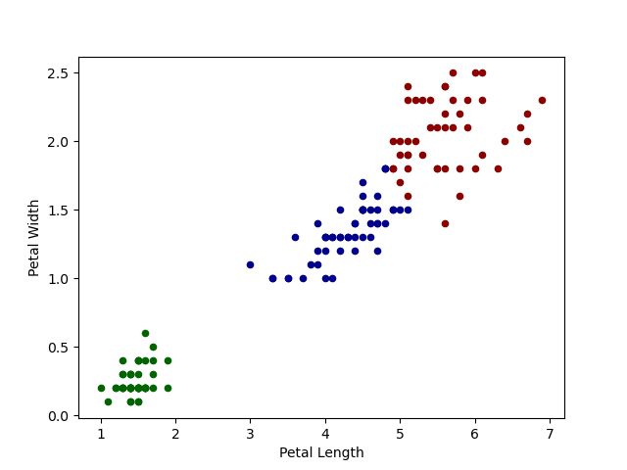
Clustering

Slide 34
4.- Similarity Joins in SPARQL

Slide 35
We propose to extend SPARQL to support a similarity join operator

Slide 36


State-of-the-art
Paper | Language | System | Multi- dimensional | Range Queries | Knn Queries | Subquadratic | Semantic
[Silva et al., 2013] | SQL | DBSimJoin
[Kiefer et al., 2007] | SPARQL 1.0 | iSPARQL
[Galkin et al., 2017] | SPARQL 1.1 | MSimJoin
[Ferrada et al., 2020] | SPARQL 1.1 | SJ-SPARQL

Slide 37
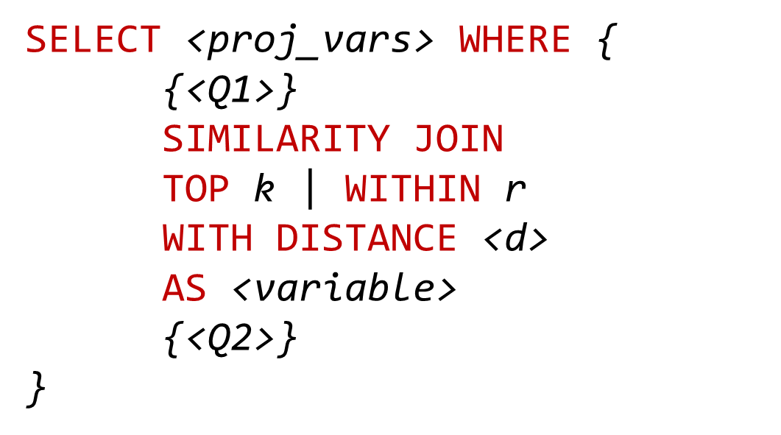
Query Evaluation Pipeline
Query Writing
Parsing
Optimisation
Execution
Result Iteration

Slide 38
SPARQL Grammar Extension
SimilarityGraphPattern ::= 'SIMILARITY JOIN ON (' Var+ ') (' Var+ ')' ('TOP' INTEGER |'WITHIN' DECIMAL ) 'DISTANCE' iri 'AS' Var GroupGraphPattern
GraphPatternNotTriples ::= GroupOrUnionGraphPattern |...| SimilarityGraphPattern

Slide 39
SPARQL Syntax Extension – Example
SELECT ?p1 ?p2 ?d WHERE {
{?p1 wdt:P31/wdt:P279* wd:Q6256 ; #countries
wdt:P4010 ?GDP1 ;
wdt:P1081 ?hdi1 ;
wdt:P30 wd:Q46 } #in Europe
SIMILARITY JOIN ON (?GDP1 ?hdi1) (?GDP2 ?hdi2)
TOP 1 DISTANCE sim:manhattan AS ?d
{?p2 wdt:P31/wdt:P279* wd:Q6256 ; #countries
wdt:P4010 ?GDP2 ;
wdt:P1081 ?hdi2 ;
wdt:P361 wd:Q12585 }} #in LATAM
Latin American countries with a similar GDP and HDI of European Countries

Slide 40
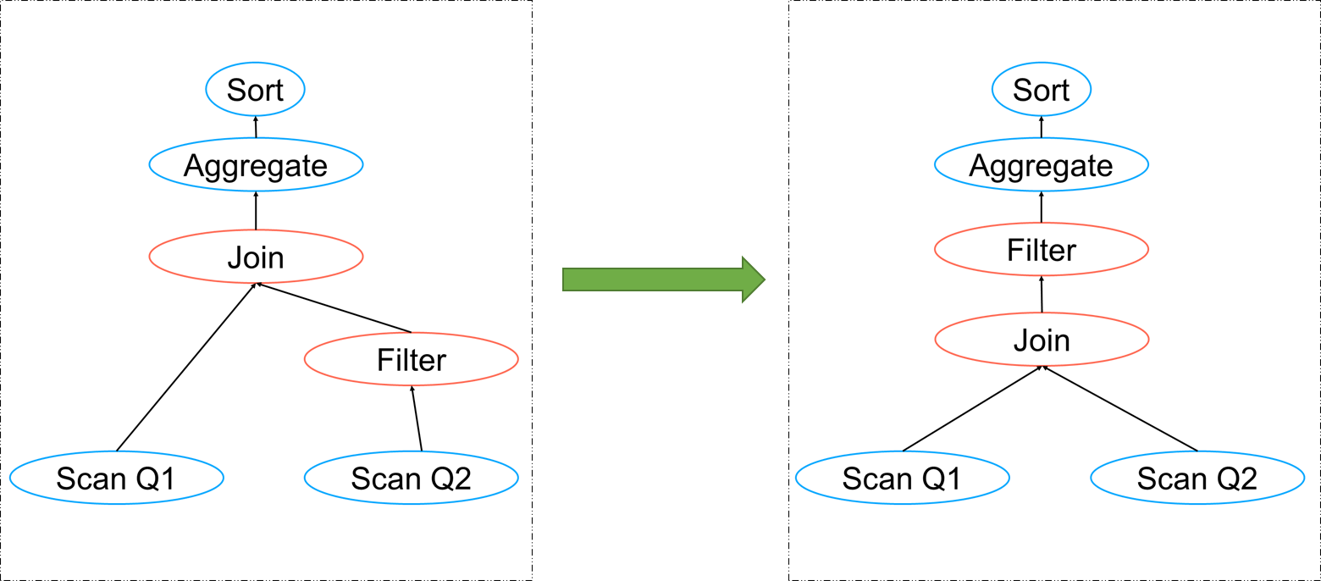
Query Evaluation Pipeline
Query Writing
Parsing
Optimisation
Execution
Result Iteration

Slide 41
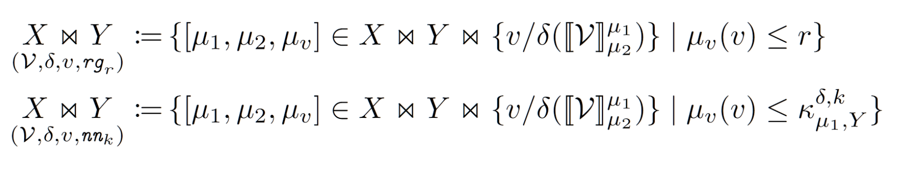
Algebra Operator
Definition 1. Given two sets of solution mappings X and Y, the evaluation of the similarity joins are defined as:

Slide 42
Query Evaluation Pipeline
Query Writing
Parsing
Optimisation
Execution
Result Iteration

Slide 43
Query Overlap Cache
SELECT ?p1 ?p2 ?d WHERE {
{?p1 wdt:P31/wdt:P279* wd:Q6256 ; #countries
wdt:P4010 ?GDP1 ;
wdt:P1081 ?hdi1 ;
wdt:P30 wd:Q46 } #in Europe
SIMILARITY JOIN ON (?GDP1 ?hdi1) (?GDP2 ?hdi2)
TOP 1 DISTANCE sim:manhattan AS ?d
{?p2 wdt:P31/wdt:P279* wd:Q6256 ; #countries
wdt:P4010 ?GDP2 ;
wdt:P1081 ?hdi2 ;
wdt:P361 wd:Q12585 }} #in LATAM

Slide 44
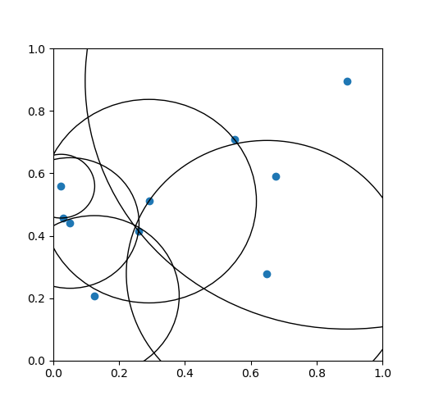
Query Evaluation Pipeline
Query Writing
Parsing
Optimisation
Execution
Result Iteration

Slide 45
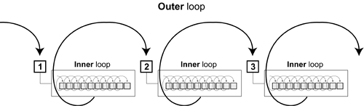
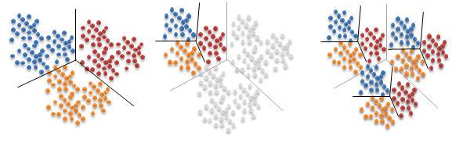
Similarity Join Strategies
Nested Loop
Vantage-point trees
FLANN

Slide 46
Strategy Comparison
1000 scenarios taken from the characteristic sets of Wikidata
Varying number of entities and properties
Self-similarity join on all properties

Slide 47
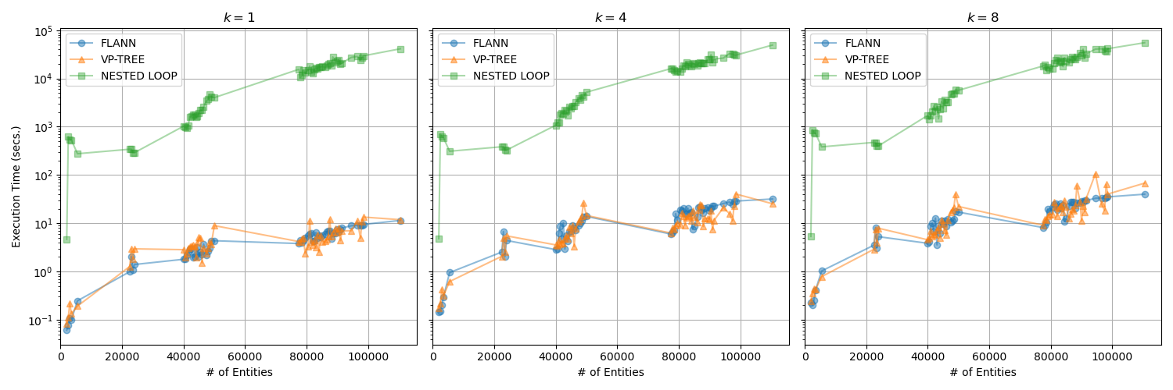
Strategy Comparison

Slide 48
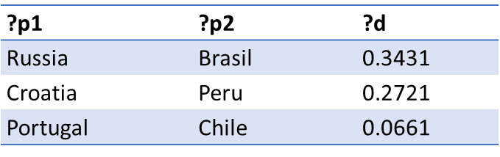
Query Evaluation Pipeline
Query Writing
Parsing
Optimisation
Execution
Result Iteration

Slide 49
5.- Use-case Queries
Notes:
wikidata has 4.632.440.812 truthy triples

Slide 50

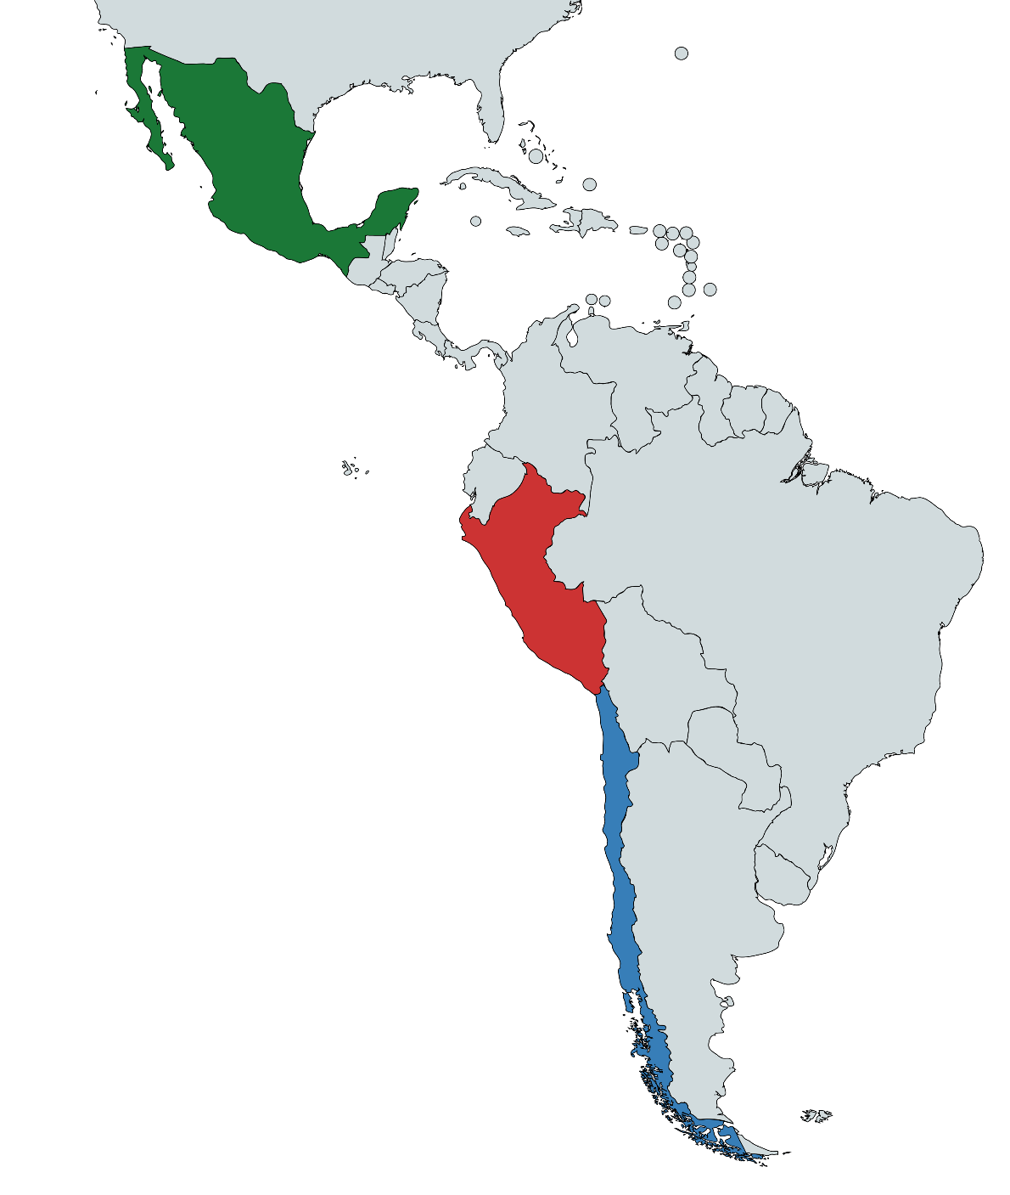
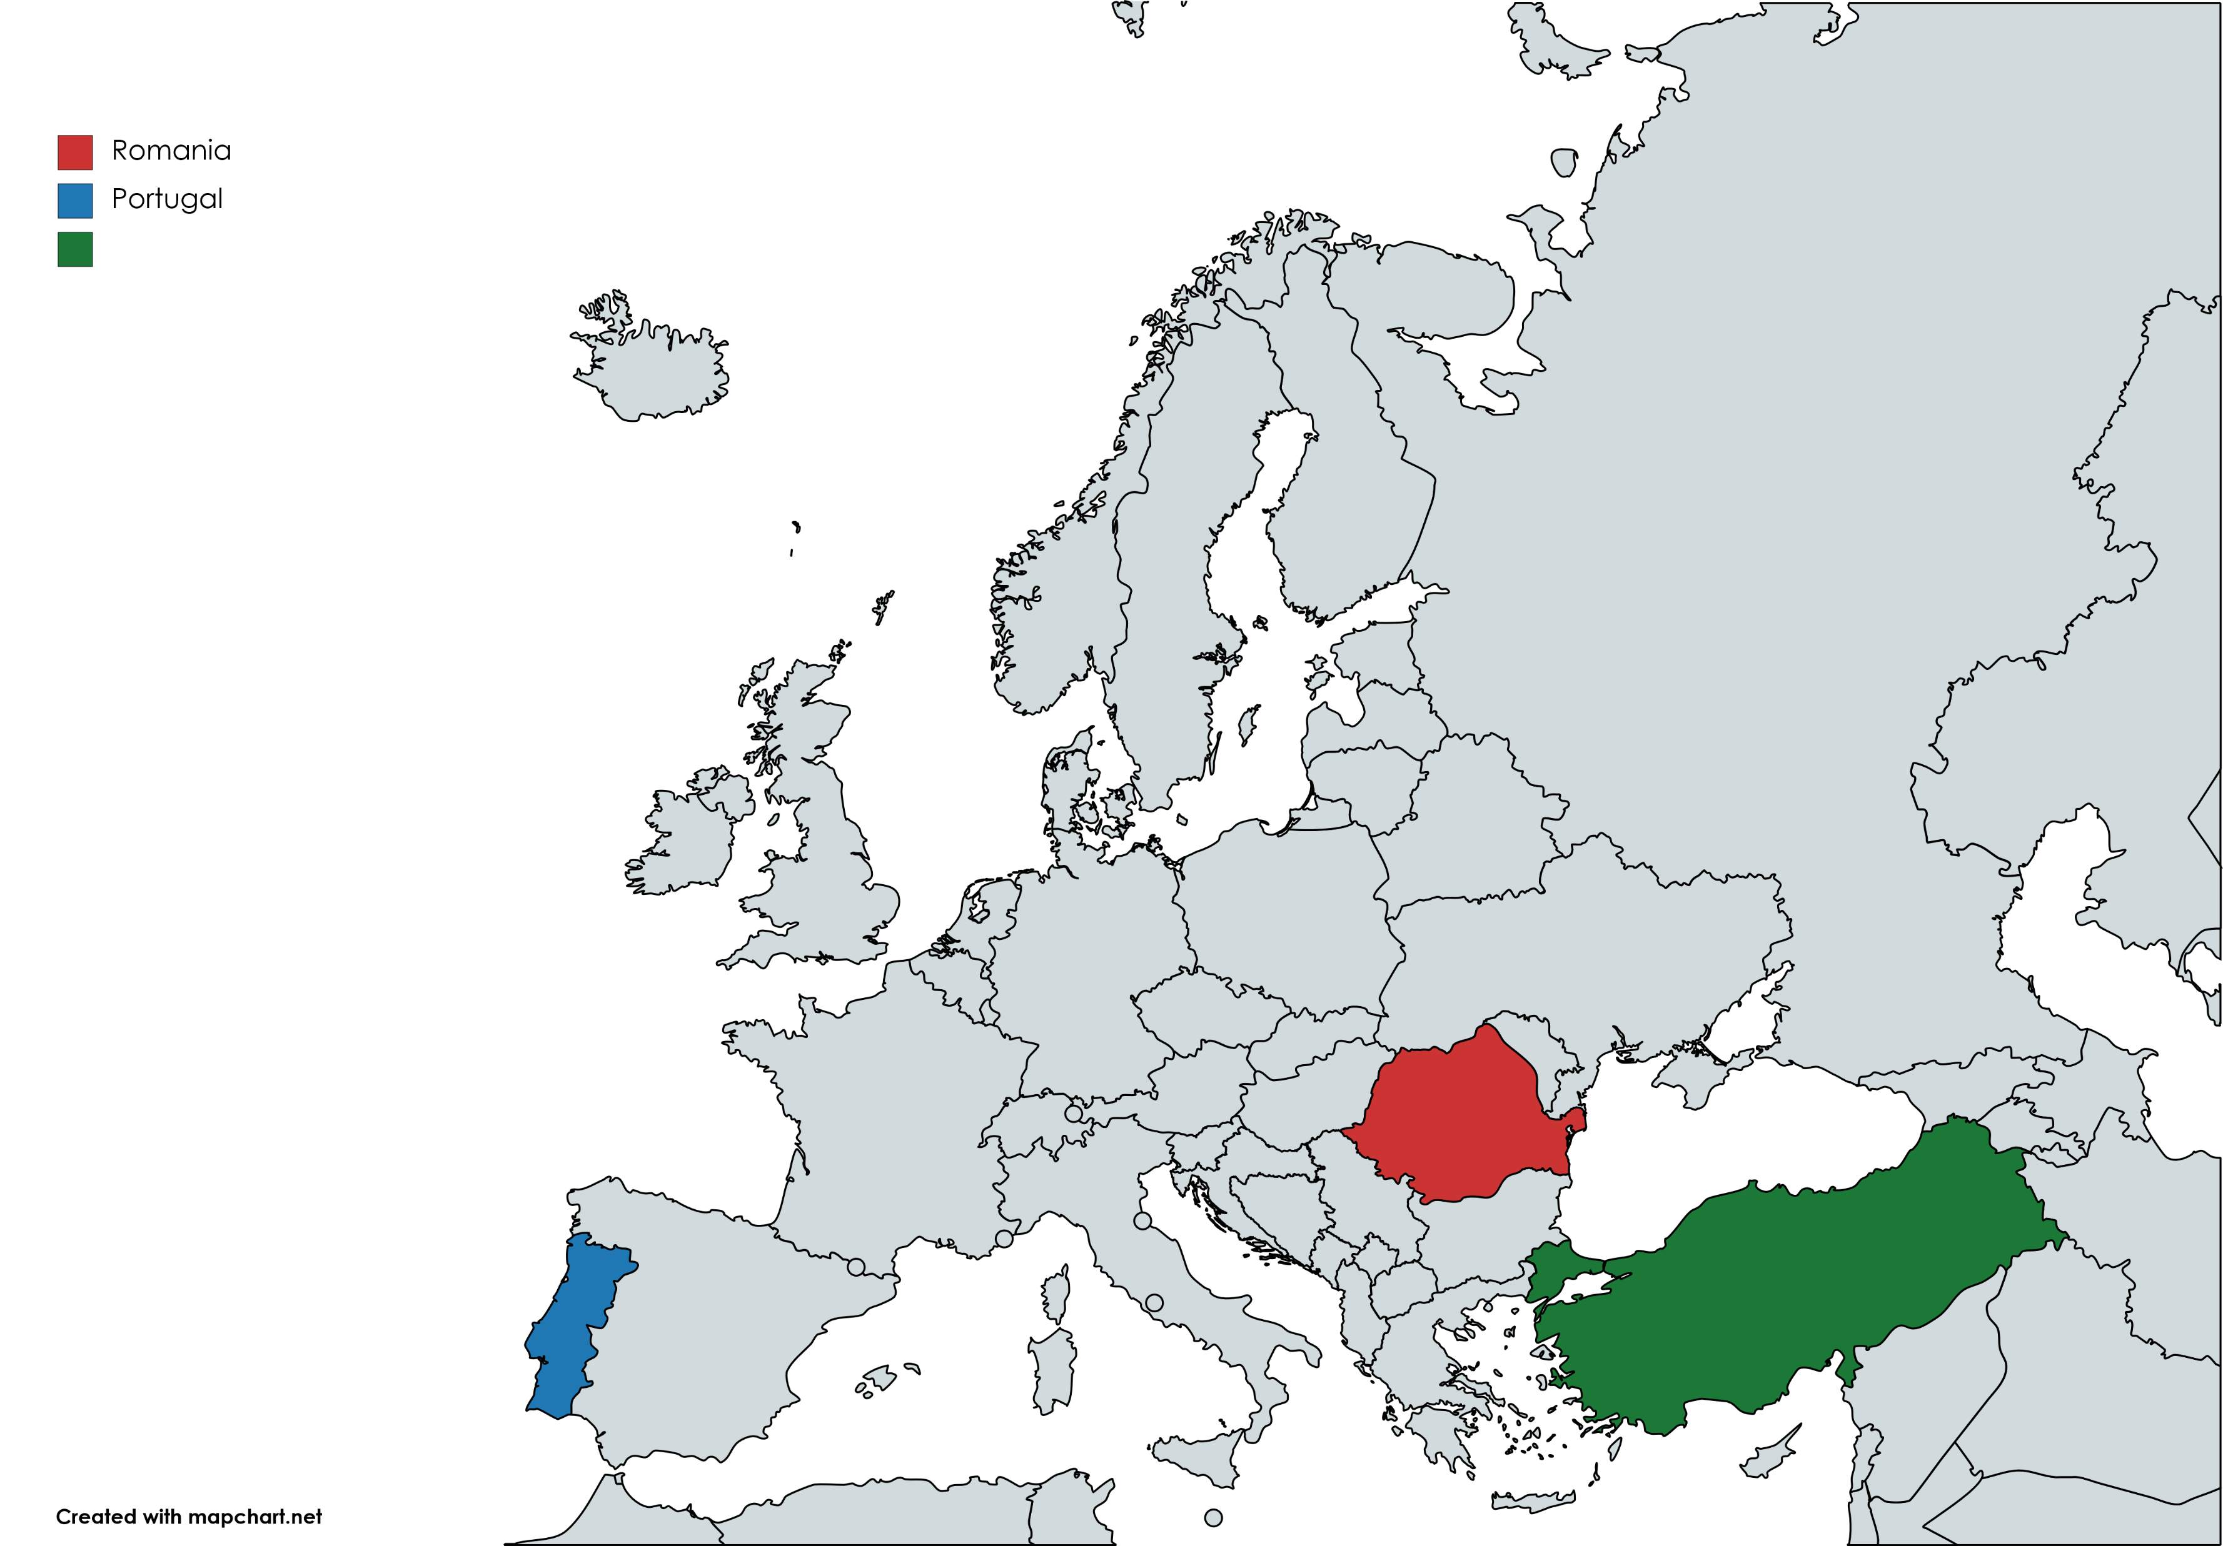
Country Similarity
?p1 | ?p2 | ?d
Romania | Peru | 0.129
Portugal | Chile | 0.134
Turkey | Mexico | 0.195
European countries similar to Latin American countries based
on welfare indicators
Notes:
Life expectancy, Nominal GDP, GDP, GDP growth rate, HDI

Slide 51
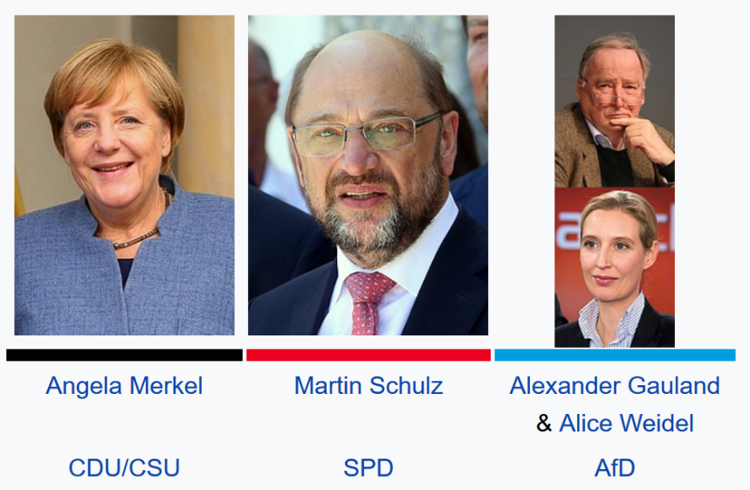
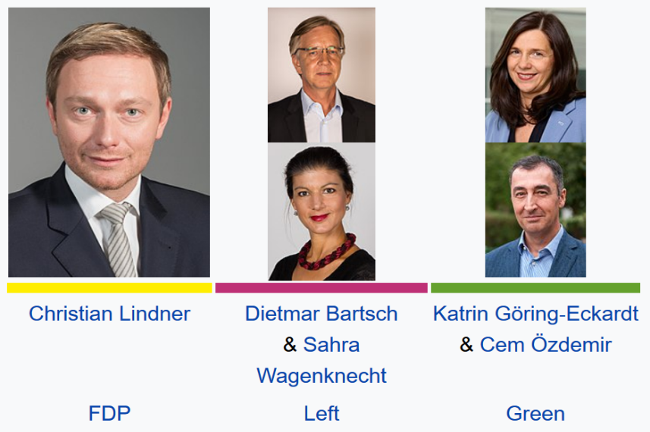
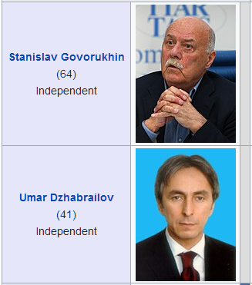
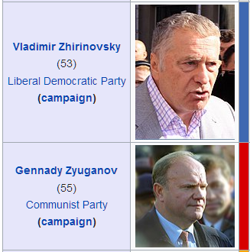
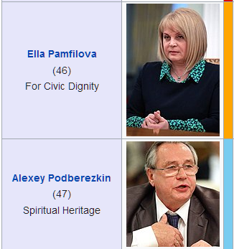
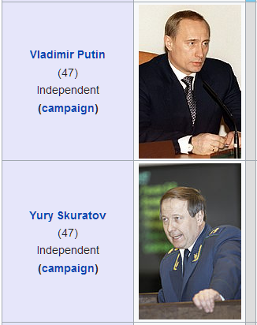
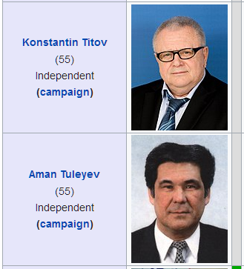
Aggregated Dimensions
The two most similar elections in terms of number of candidates,
different parties and different political philosophies

Slide 52

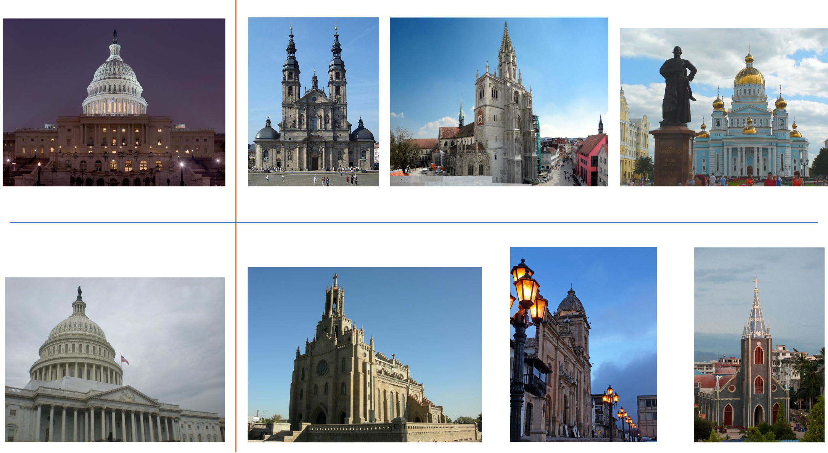
Image Similarity
Images of churches similar to images of the US Capitol building

Slide 53
Potential Use Cases
Data Integration
Entity Linking
Query Relaxation
Text Mining

Slide 54
6.- Implementation

Slide 55

Apache Jena
Open source SPARQL engine and
RDF storage system
Our implementation is integrated in Jena, providing all the required interfaces and objects to parse and execute similarity joins
Result iteration follows the fetch-as-needed philosophy of other operators
Notes:
Grammar compiled with JavaCC
Optimises and executes algebra trees
Results fetched as needed
It allows normal flow of non-similarity queries, our implementation only takes over to solve similarity joins
Nested loops, vp-trees, flann and quickjoin solvers are implemented
This behaviour avoids the storage of a possible quadratic number of results

Slide 56
7.- Evaluation

Slide 57
Related Works – iSPARQL
SELECT ?pub1 ?pub2 ?sim WHERE {
?pub1 rdfs:label ?title1 ;
opus:book_title ?booktitle1 .
?pub2 swrc:label ?title2 ;
swrc:book_title ?booktitle2 .
IMPRECISE {
?sim1 isparql:jac (?title1 ?title2).
FILTER (?sim1 >= 0.5) .
?sim2 isparql:lev (?booktitle1 ?booktitle2).
FILTER (?sim2 >= 0.5) .
?sim isparql:score (?sim1 ?sim2 0.6 0.4).
FILTER (?sim >= 0.5)}
} ORDER BY DESC(?sim)

Slide 58
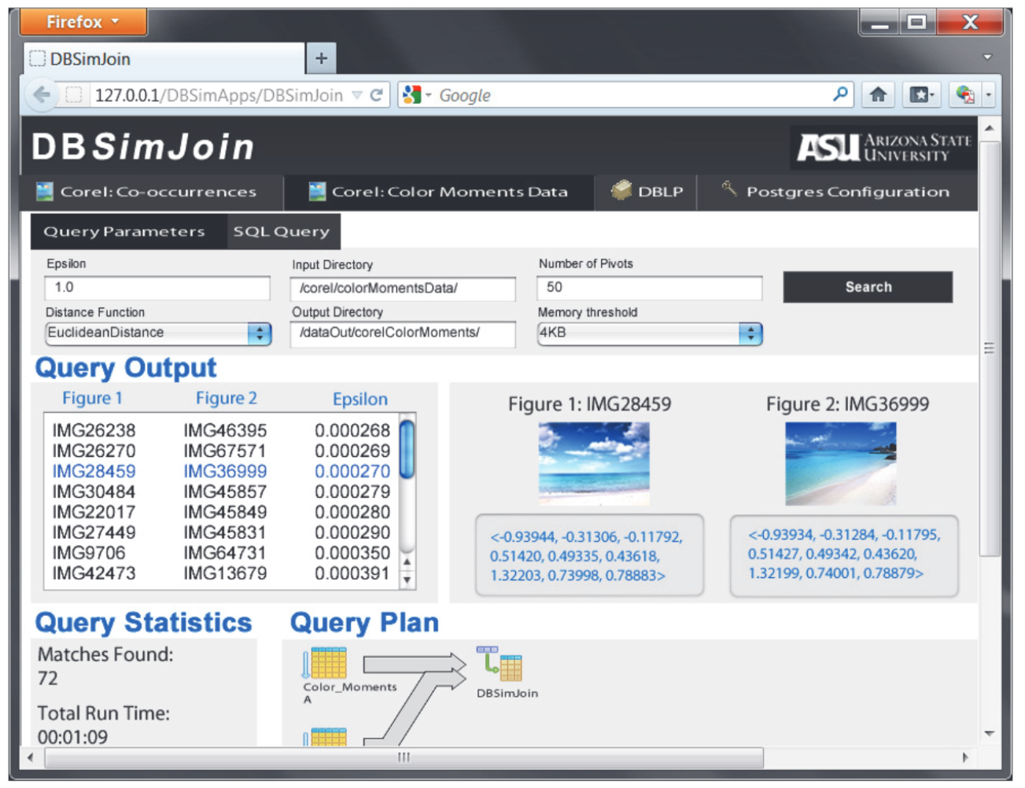
Related Works – DBSimJoin
G
L
r
r

Slide 59
System Evaluation – iSPARQL
Compared to iSPARQL our implementation has the following advantages:
It is more efficient – avoids nested loops
It requires less memory – avoids virtual triples
It can handle an arbitrary number of properties instead of using pairwise property similarities

Slide 60
System Evaluation – DBSimJoin
We compared our system to DBSimJoin.
DBSimJoin implements Quickjoin. We compared with our implementation with VP-trees.
We employ the same setup that on DBSimJoin Paper, and used increasingly larger values for the search radius

Slide 61
System Evaluation

Slide 62
System Evaluation

Slide 63
8.- Clustering in SPARQL

Slide 64
CLUSTER BY Query Modifier
Defined by Ławrynowicz for SPARQL 1.0 (no GROUP BY)
SELECT ?x ?latitude ?longitude ?c WHERE {
?x rdf:type ex:NaturalMonument
?x locatedIn ex:East_Central_Europe
?x geo:lat ?latitude
?x geo:long ?longitude
}
CLUSTER BY ?latitude ?longitude AS ?c
USING sqrco:ExampleMethod (
sqrco:ExampleMethod sqrco:usesAlgorithm weka:SimpleKMeans
weka:SimpleKMeans smo:hasParam ?p1
?p1 rdf:type sqrco:NumberOfClusters
?p1 owl:hasValue xsd:integer(‘4’))

Slide 65
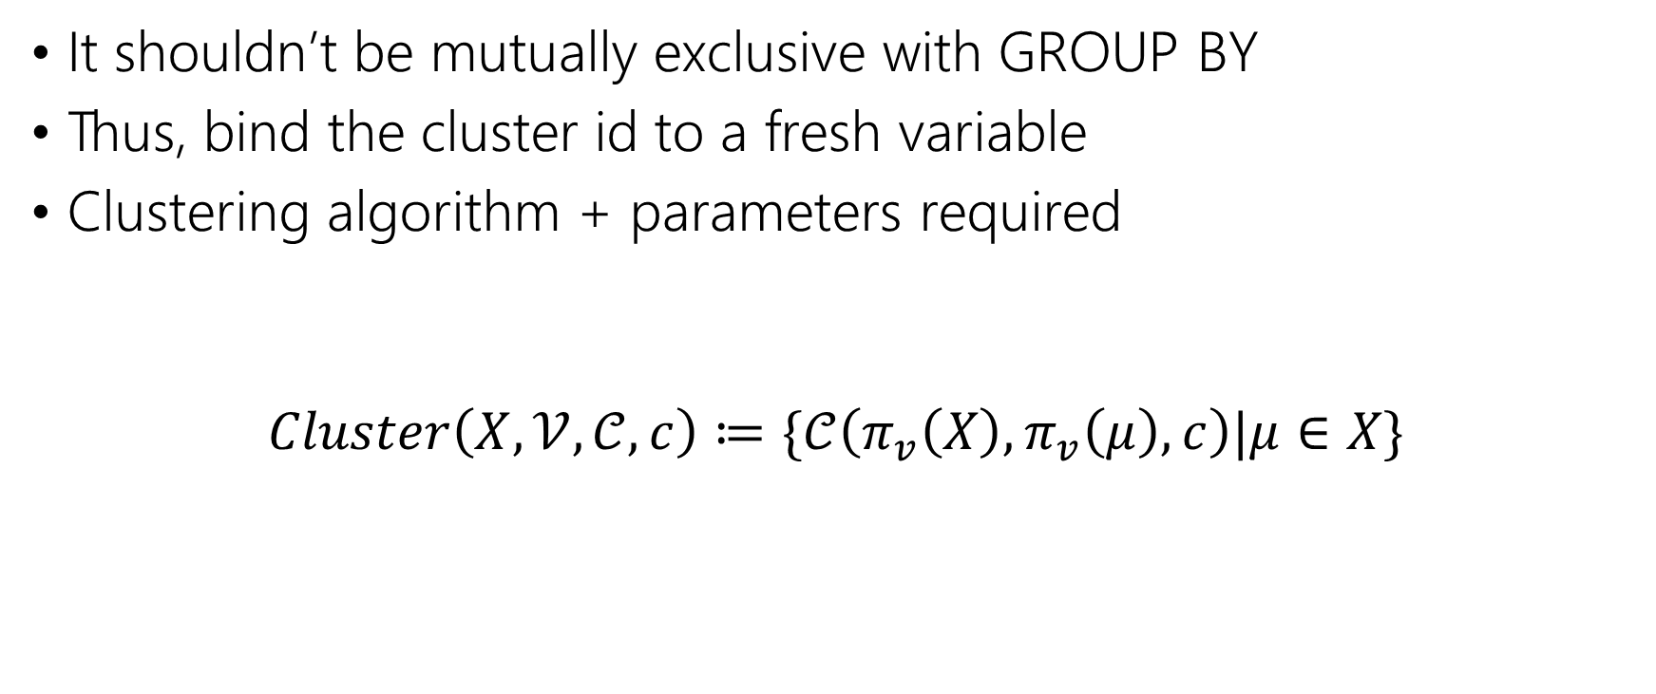
CLUSTER BY Query Modifier
It shouldn’t be mutually exclusive with GROUP BY
Thus, bind the cluster id to a fresh variable
Clustering algorithm + parameters required
$$Cluster\left(X, 𝒱, 𝒞,c\right)≔\{𝒞\left(π_{v}\left(X\right), π_{v}\left(μ\right),c\right)|μ∈X\}$$

Slide 66
The Similarity Ontology
Uses the Function ontology to provide the clustering algorithm and parameters.
sim:kmedoids a fno:Function ;
dcterms:description "The k-medoids clustering algorithm";
fno:expects sim:intParameterK .

Slide 67
CLUSTER BY Query
SELECT ?lifex ?growth ?c WHERE{
?c1 wdt:P31 wd:Q6256 ; #countries
wdt:P2250 ?lifex ;
wdt:P2219 ?growth .
}
CLUSTER BY ?lifex ?growth AS ?c
WITH(
_:x fno:executes sim:kmeans ;
sim:numberOfClusters "4"^^xsd:integer .
)

Slide 68
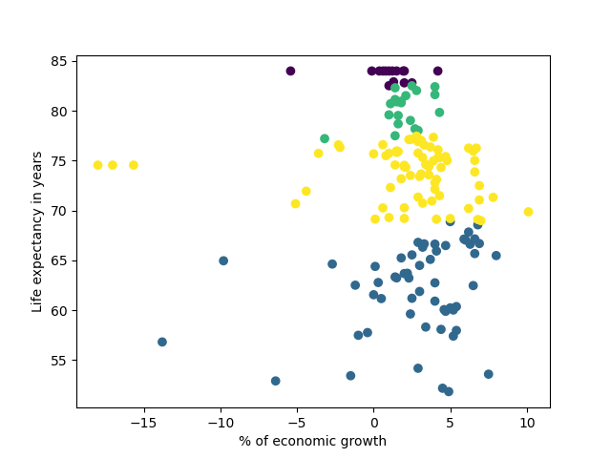
CLUSTER BY Query

Slide 69
9.- Conclusions & the Future

Slide 70
Conclusions
We presented the design, implementation and evaluation of a system supporting similarity queries over RDF Datasets
Query Writing
Parsing
Optimisation
Execution
Result Iteration
Notes:
We propose novel syntax and semantics to add a similarity join operator to SPARQL
We provide an open implementation of similarity joins on top of Apache Jena
We illustrate several use-case queries
We show the system outperforms the state-of-the-art

Slide 71
Lessons Learnt
Similarity joins and clustering are an useful feature for SPARQL
Range queries are unintuitive in abstract metric spaces; providing k-nn is key, but it is harder to implement
Similarity joins can take up to quadratic time, but we show that their computation is feasible in practice
Syntax is tricky to define, specially since similarity joins require many parameters

Slide 72
Lessons Learnt
A SPARQL/RDF setting raises unique challenges for similarity queries, namely, the need for normalisation, the consideration of unbound, missing and multiple values, etc.
It would be interesting to see similarity joins adopted in future versions of SPARQL.

Slide 73


Future Work
Perform experiments on the usability of the syntax and the system, compared with standard SPARQL

Slide 74

Future Work
Experiment with different query rewritings and other query optimisation techniques

Slide 75

Future Work
Find other relevant use-cases or domains that can benefit from this tool. Ideas are welcome!

Slide 76
Similarity-based SPARQL Operators
Sebastián Ferrada
scferradaa@gmail.com
sferrada.com

Slide 77
SPARQL Query – Similar Countries
SELECT ?c1 ?c2 ?d WHERE{
{?c1 wdt:P31 wd:Q6256 ; # Countries
wdt:P2250 ?lifex1 ; wdt:P2131 ?ngdp1 ; # Life expectancy, Nominal GDP
wdt:P4010 ?gdp1 ; wdt:P2219 ?growth1 ; # GDP, GDP growth rate
wdt:P1081 ?hdi1 ; wdt:P361 wd:Q12585} # HDI, Latin America
SIMILARITY JOIN
ON (?lifex1 ?ngdp1 ?gdp1 ?growth1 ?hdi1)
(?lifex2 ?ngdp2 ?gdp2 ?growth2 ?hdi2)
TOP 1 DISTANCE sim:manhattan AS ?d # 1-nn using Manhattan
{?c2 wdt:P31 wd:Q6256 ; # Countries
wdt:P2250 ?lifex2 ; wdt:P2131 ?ngdp2 ; # Life expectancy, Nominal GDP
wdt:P4010 ?gdp2 ; wdt:P2219 ?growth2 ; # GDP, GDP growth rate
wdt:P1081 ?hdi2 ; wdt:P30 wd:Q46}} # HDI, Europe

Slide 78
SPARQL Query – Similar Elections
SELECT ?e2 ?c1 ?c2 ?p1 ?p2 ?d WHERE{
{SELECT (wd:Q15062956 AS ?e1)
(COUNT(DISTINCT ?candidate) AS ?c1)
(COUNT(DISTINCT ?party) AS ?p1)
(COUNT(DISTINCT ?ideology) AS ?i1) WHERE{
wd:Q15062956 wdt:P726 ?candidate . # candidates
?candidate wdt:P102 ?party . ?party wdt:P1387 ?ideology.}} # parties, ideologies
SIMILARITY JOIN ON (?c1 ?p1 ?i1) (?c2 ?p2 ?i2)
TOP 4 DISTANCE sim:manhattan AS ?d # 4-nn using Manhattan
{SELECT ?e2 (COUNT(DISTINCT ?candidate) AS ?c2)
(COUNT(DISTINCT ?party) AS ?p2)
(COUNT(DISTINCT ?ideology) AS ?i2) WHERE{
?e2 wdt:P31/wdt:P279* wd:Q40231 ; wdt:P726 ?candidate . # elections, candidates
?candidate wdt:P102 ?party . ?party wdt:P1387 ?ideology . # parties, ideologies
} GROUP BY ?e2}}

Slide 79
SPARQL Query – Similar Images
SELECT ?img1 ?img2 WHERE{
{?img1 imo:associatedWith wd:Q54109 . # Capitol Building
?vector1 a imo:HOG ;
imo:describes ?img1 ;
imo:value ?hog1 .} # HOG descriptor
SIMILARITY JOIN ON (?hog1) (?hog2) TOP 3
DISTANCE sim:manhattan AS ?d # 3nn w/ Manhattan
{?cathedral wdt:P31 wd:Q2977 . # Cathedrals
?img2 imo:associatedWith ?cathedral .
?vector2 a imo:HOG ;
imo:describes ?img2 ;
imo:value ?hog2 .}} # HOG descriptor

